Slide 1
Illustrations
Introduction to LabBench

Slide 2
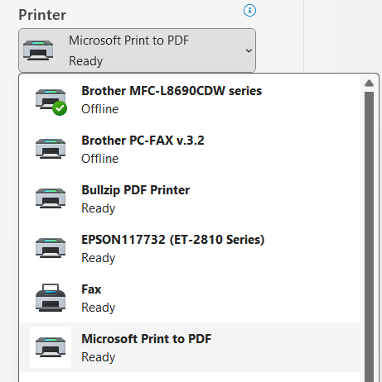

Slide 3
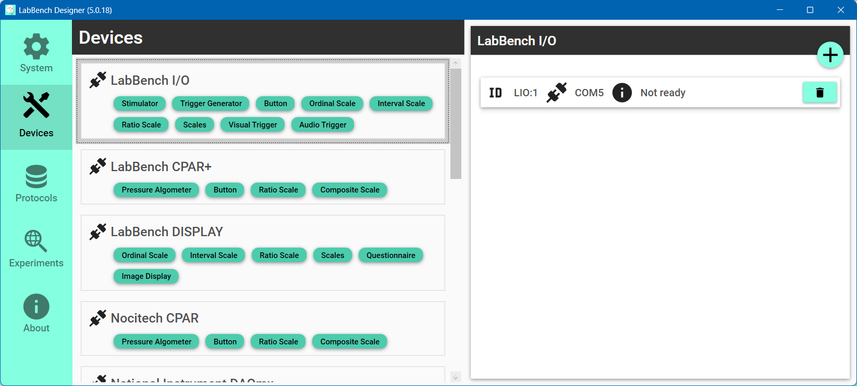

Slide 4

Select the Devices page
Click the “Scan and add” button
Select the type of instrument to add

Slide 5
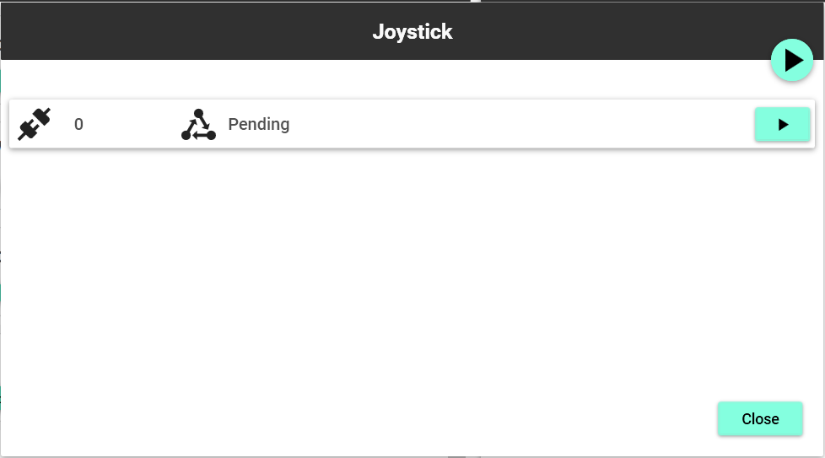
“Scan all connections” button
“Scan connection” button

Slide 6
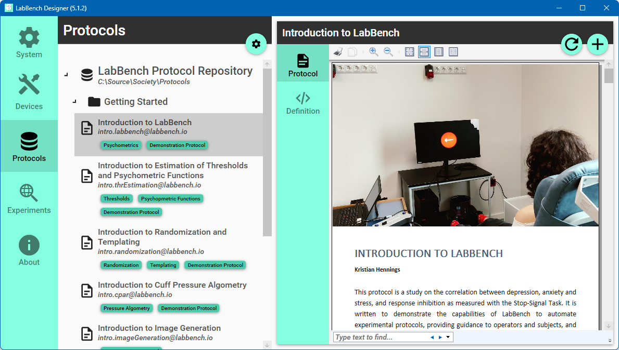
Select the LabBench Protocol Repository
Select the Protocols page
Click the “Install protocol” button
Select Introduction to LabBench
Notes:
Joystick Experimental Setup

Slide 7
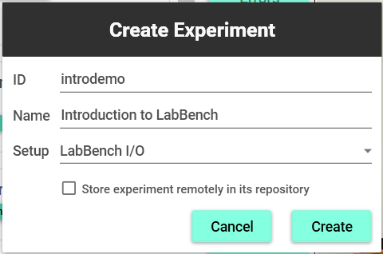
ID of the experiment that must be unique
Name that is displayed to the experimenter
Experimental setup variant
Store the protocol in the repository
Click to create the experiment

Slide 8
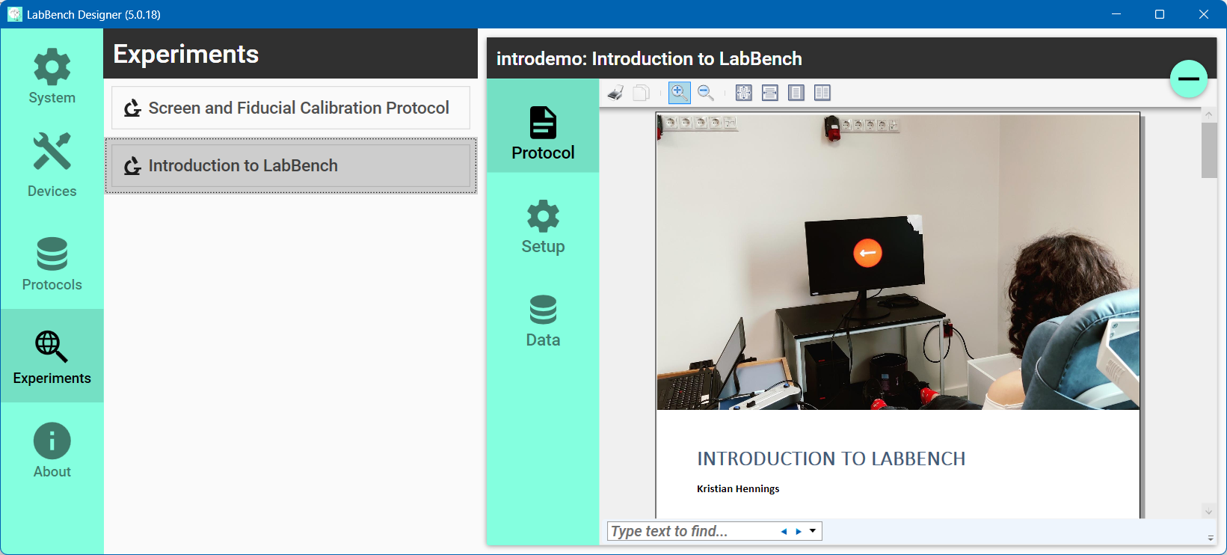
Select the experiment to manage
Select the Experiments page
Content of experiment page
Select the experiment page

Slide 9
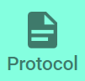

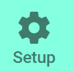




Slide 10
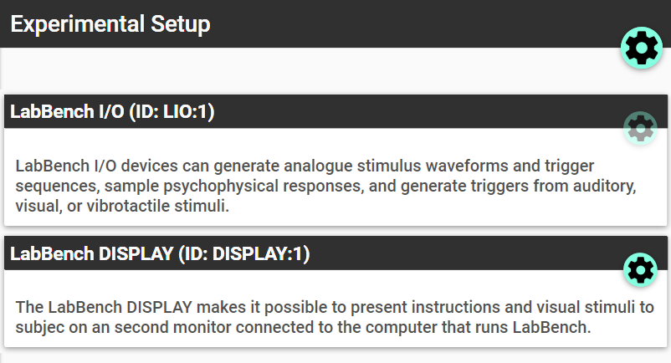
Assign equipment
Configure device

Slide 11
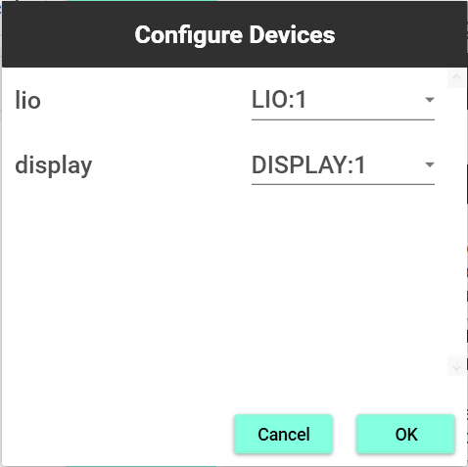
ID of the device in the protocol
Equipment ID from the Devices Page

Slide 12
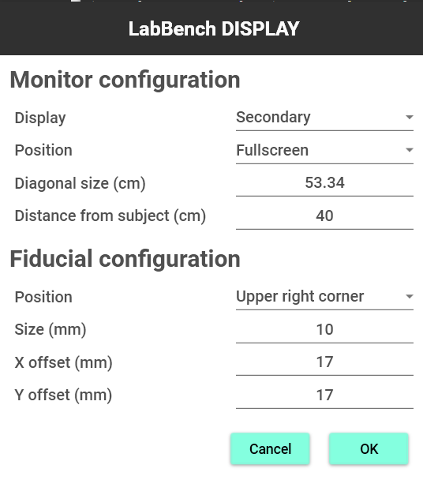

Slide 13
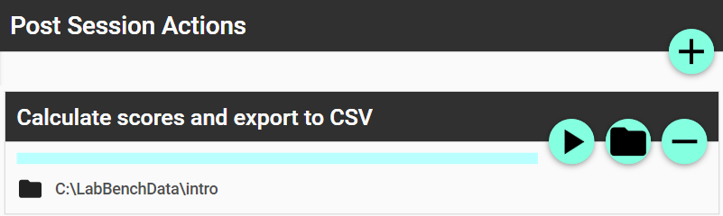
Rerun action
Change output directory

Slide 14
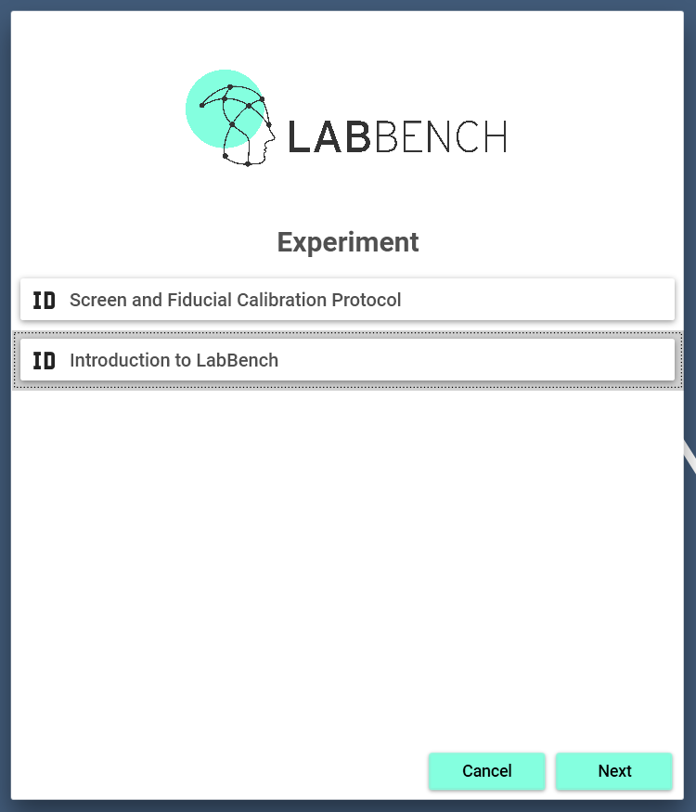
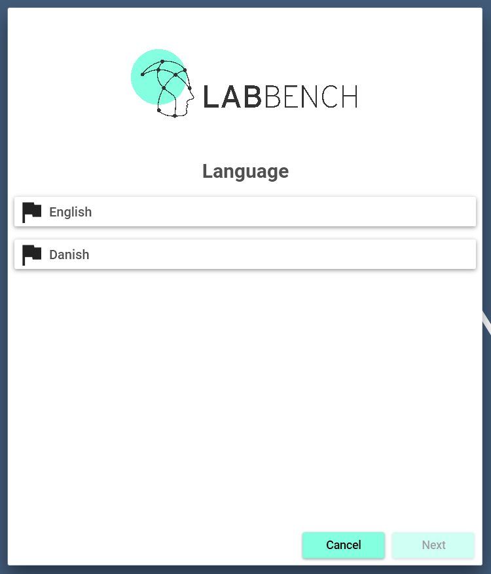
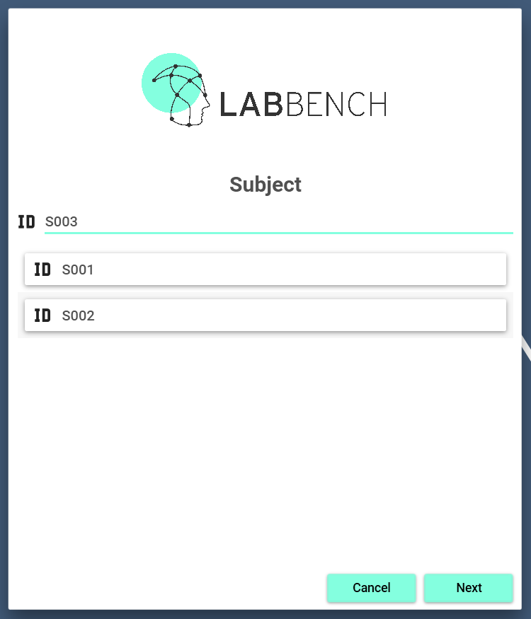
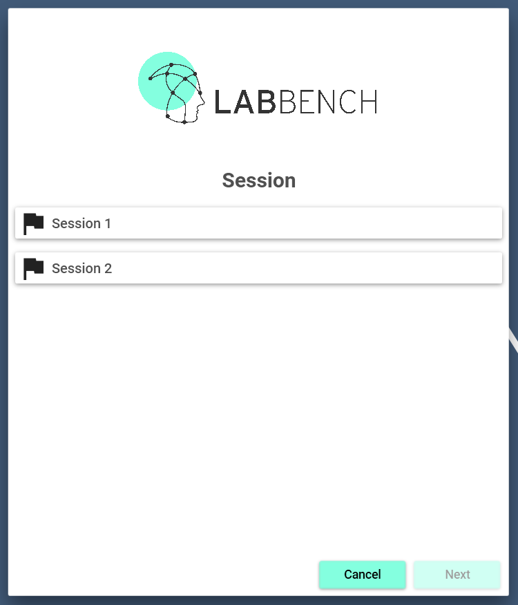
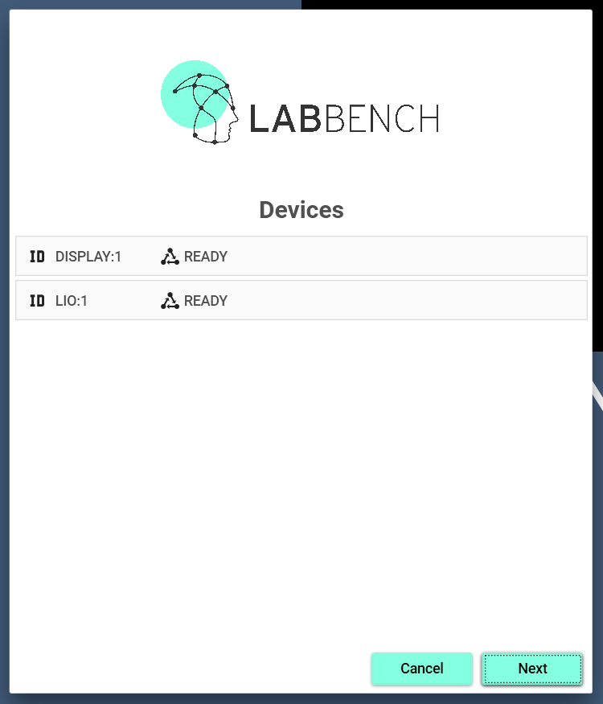
Experiment
Language
(Optional)
Subject
Session
(Optional)
Devices
(Optional)
Start
Is it localized?
Is it multi-session?
Does it use
devices?
LabBench Runner
Yes
Decision about the progress in the Startup Wizard.
No

Slide 15
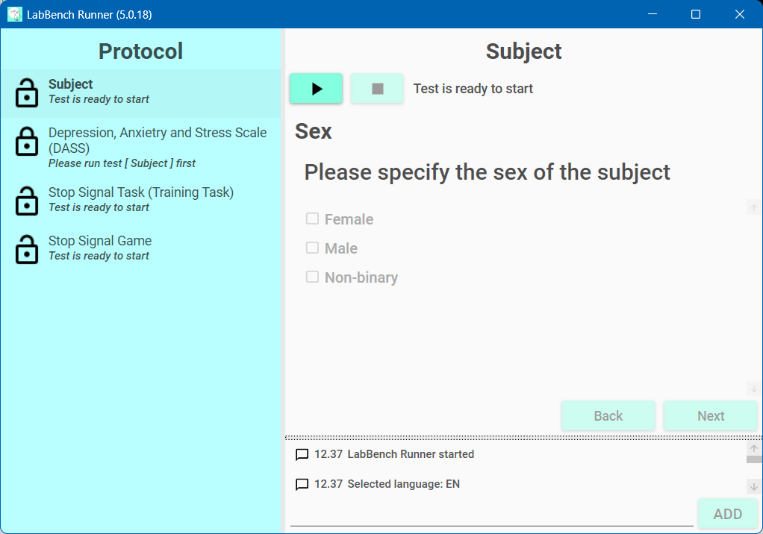
Test control and information
Protocol
Test window
Log window

Slide 16
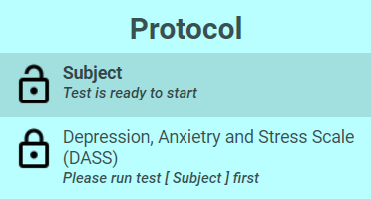
Test name
State icon
Test status

Slide 17

Test name
Test status
Abort the test
Start the test

Slide 18
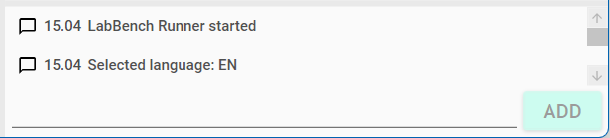
Log entries
Manual log entry
Add manual log entry

Slide 19
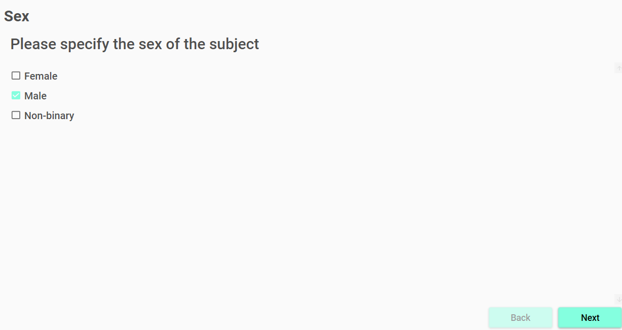
Manual test controls

Slide 20
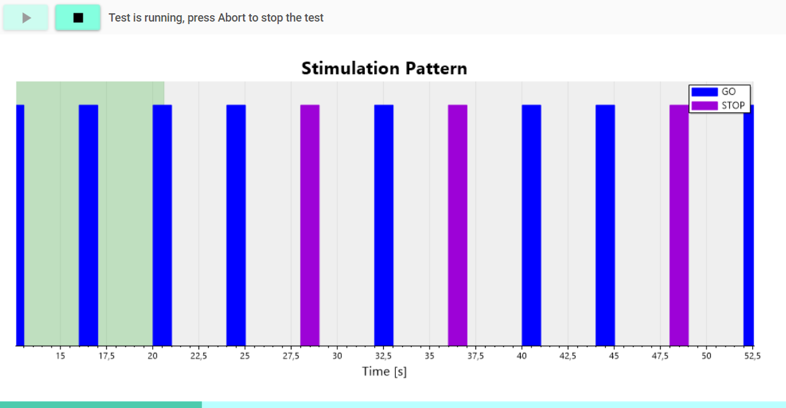

Slide 21
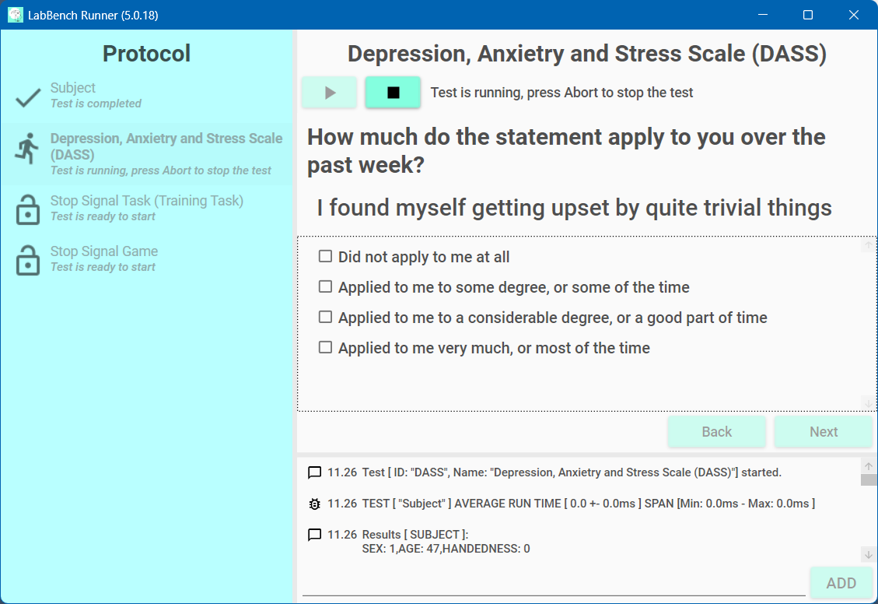

Primary Screen
Secondary Screen (LabBench Display)

